Slide 1

Indoor climate monitor
Group 7

Slide 2
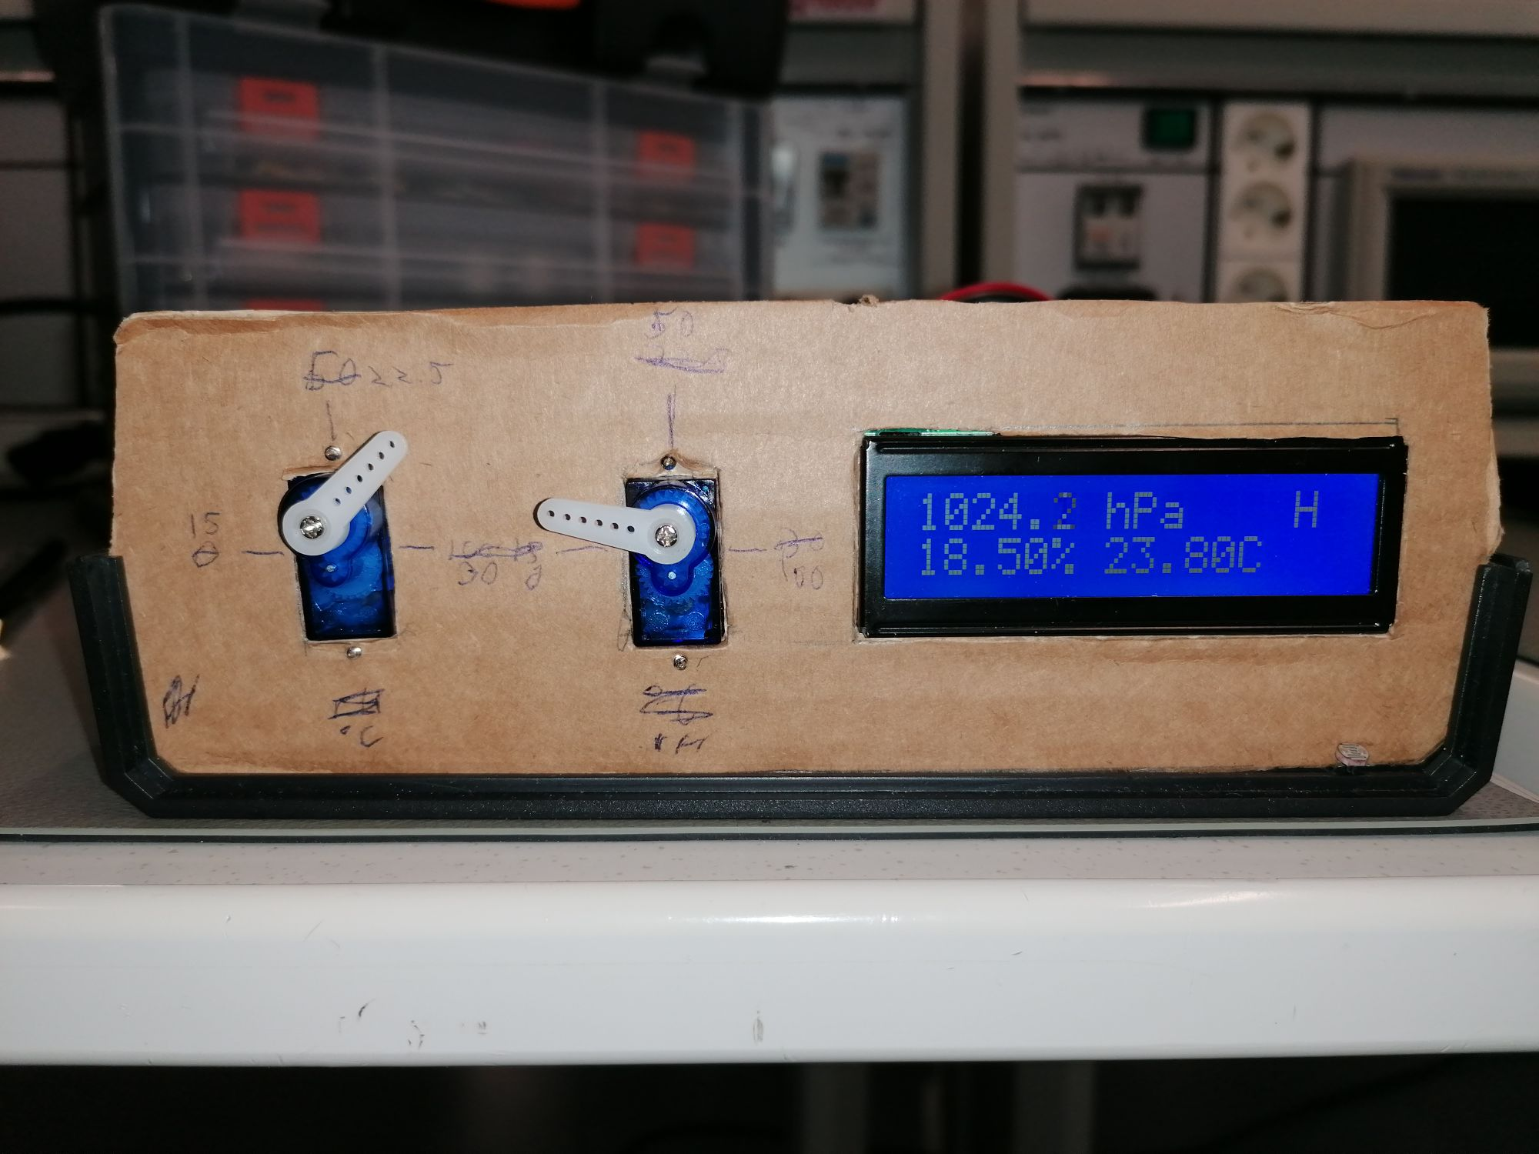
Features
Indoor climate monitor shows temperature, barometric pressure, relative humidity and the amount of light in the room.
Temperature and relative humidity are also visualized with the servos for faster reading. (Not really)
Amount of light is shown in the commonly used binary goblin to human scale. (H= Human G= Goblin)

Slide 3
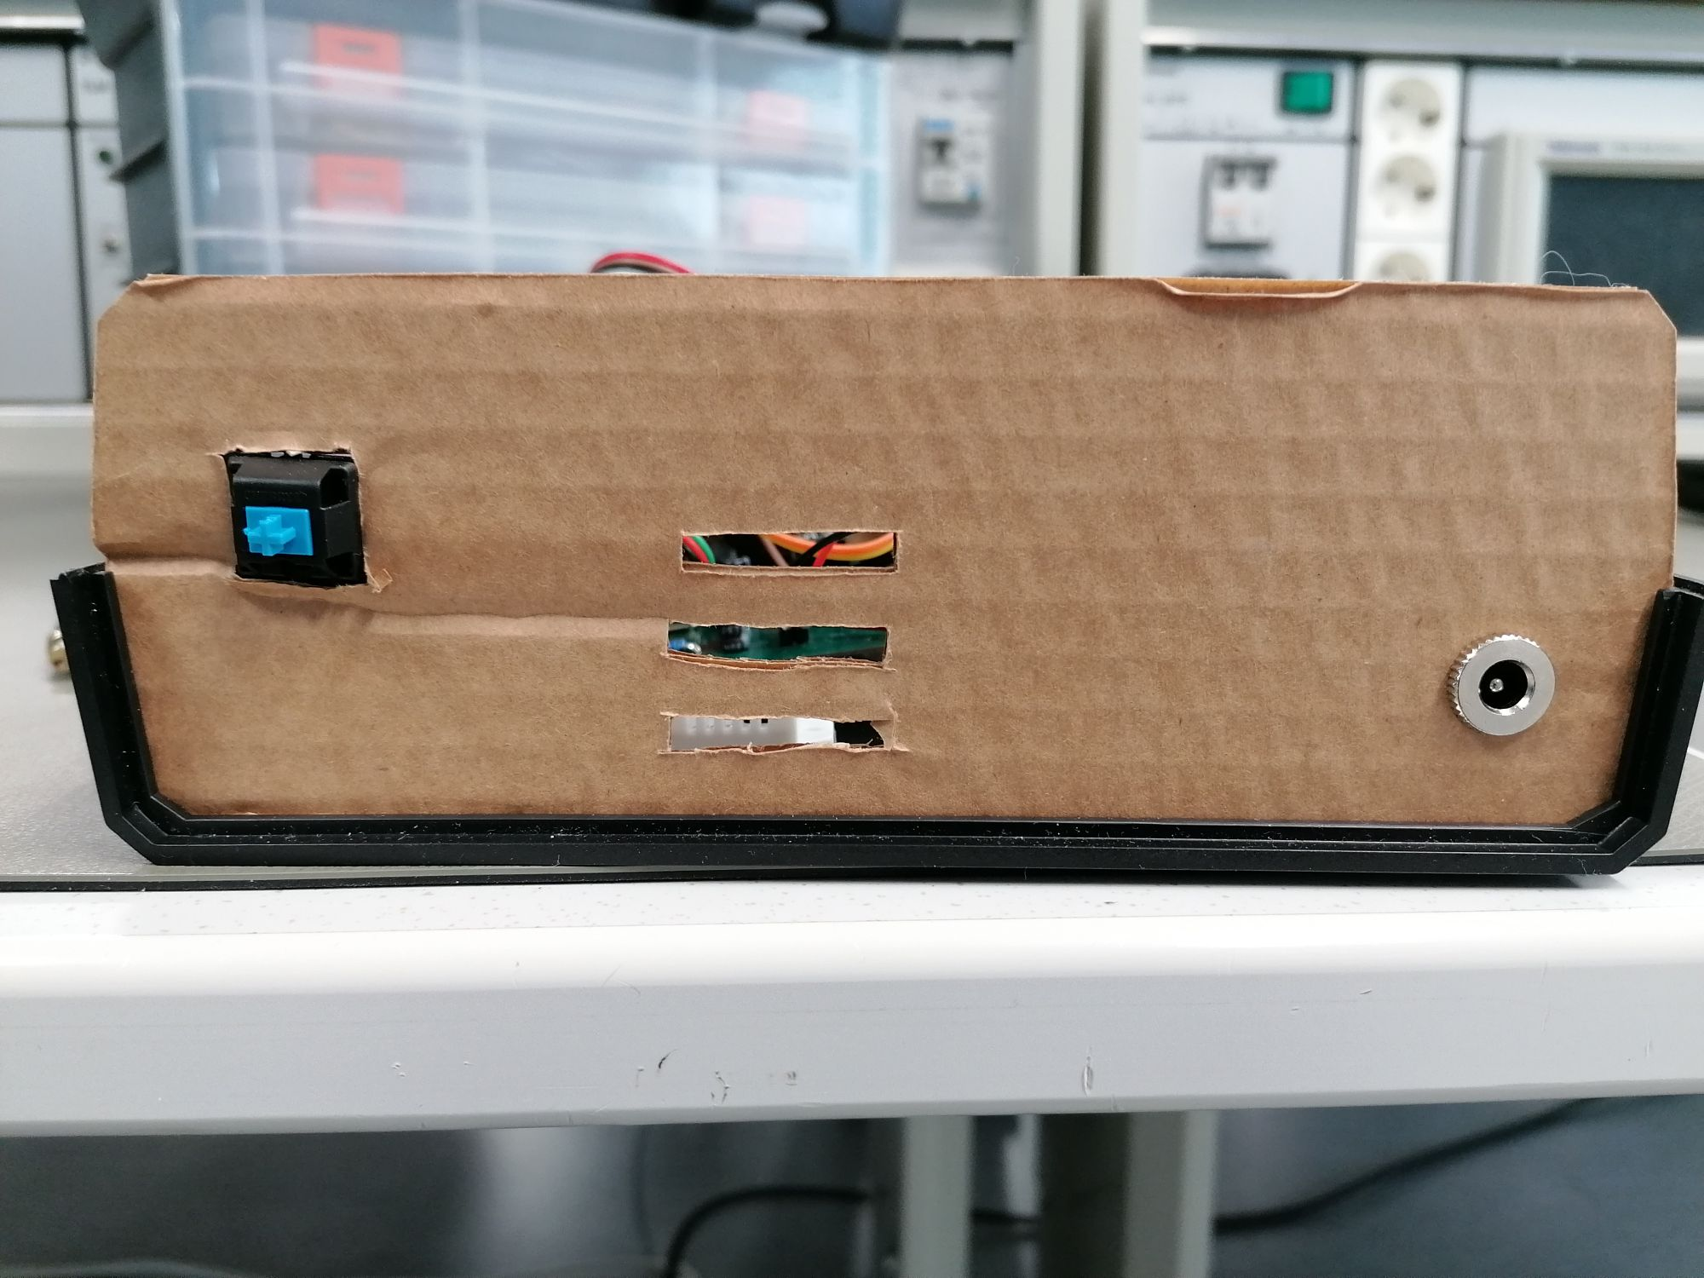
Power
Powered by a single 9V battery.
The 9V from the battery is regulated to 5V with LM7805 linear regulator.
Servos need external 5V to work.
Has very high quality cherry mx blue switch as power button! (Rated at 50 million keystrokes)

Slide 4
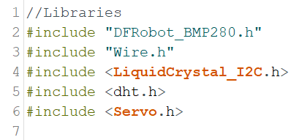
The code
The program uses five libraries
Wire.h is used for I2C communication between the LCD controller and the barometer
LiquidCrystal_I2C.h is for controlling the LCD through the controller
Dht.h is for the hygrometer
DFRobot_BMP280.h is for the barometer
Servo.h is used to control the... servos

Slide 5
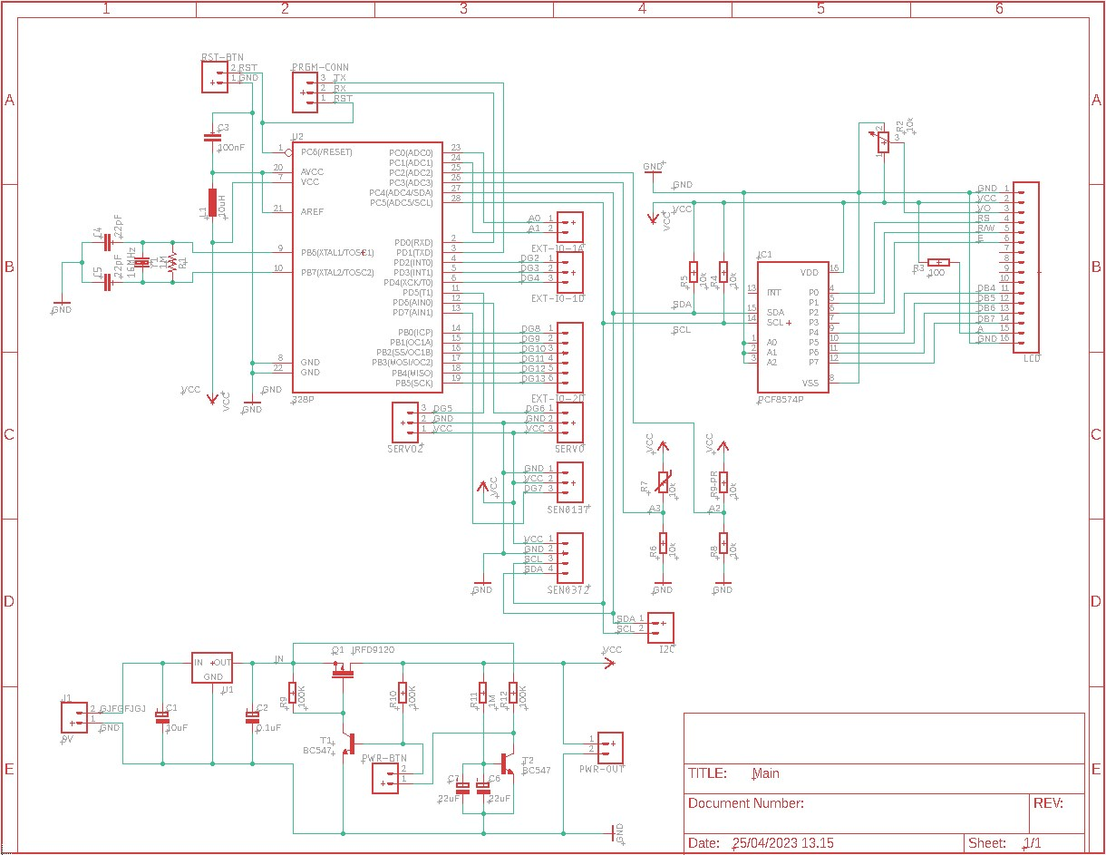
Schematic
Schematic made in EAGLE CAD.
There is a mistake in the design that caused the 9V input to be connected to the 5V that comes from the regulator.

Slide 6
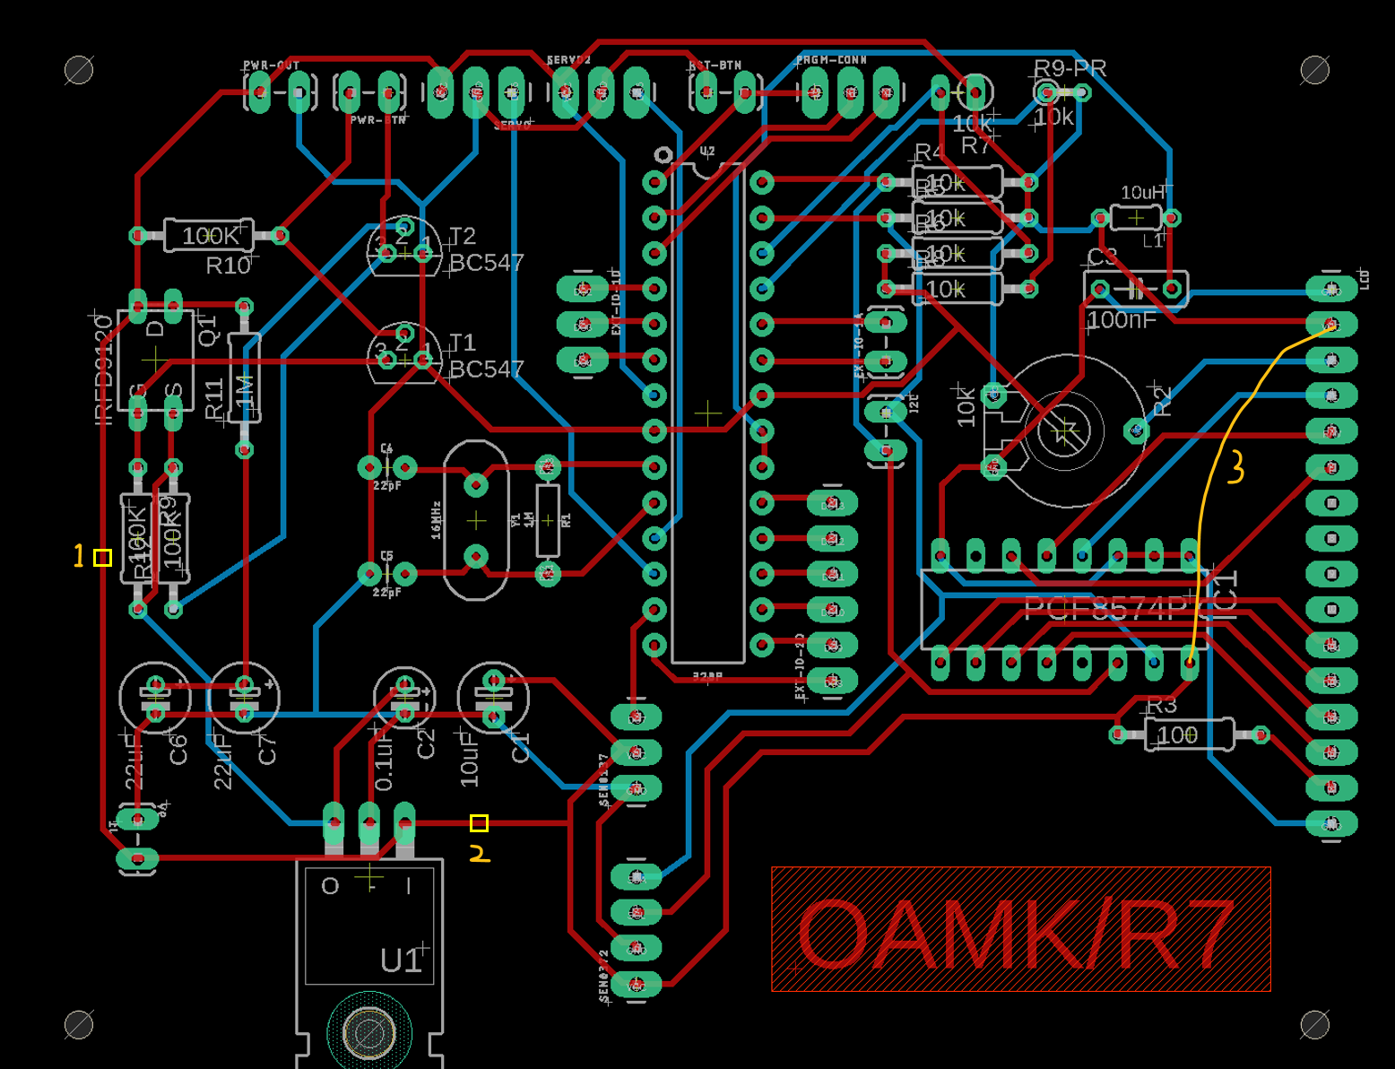
Board
Board designed in EAGLE CAD.
In the picture traces marked 1 and 2 had to be cut due to a design error.
Wire marked 3 had to be soldered due to the same error

Slide 7
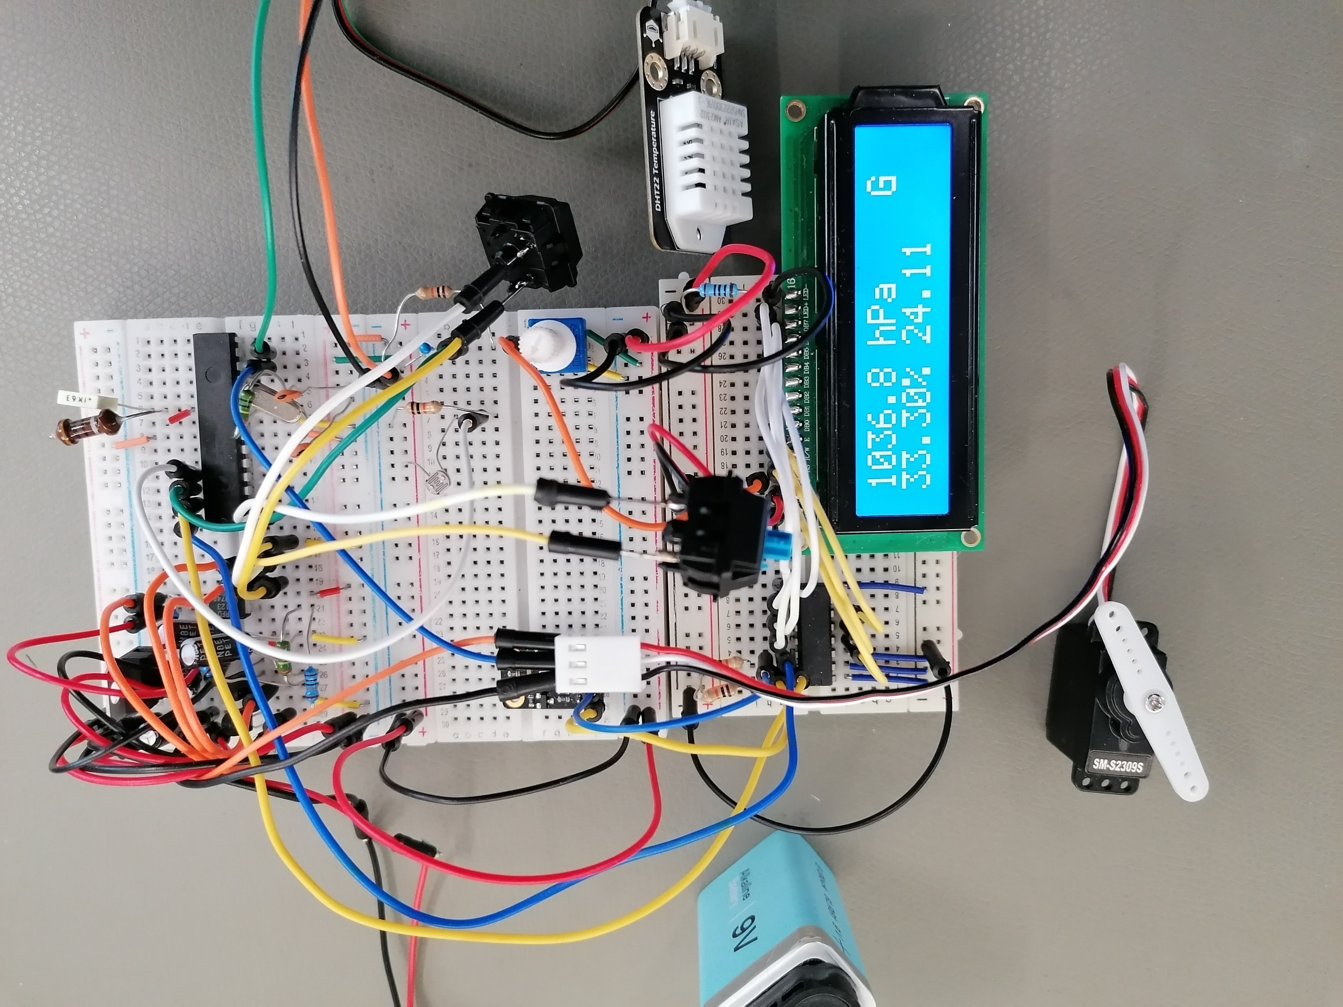
Prototype
First fully functional prototype build on prototyping boards.

Slide 8
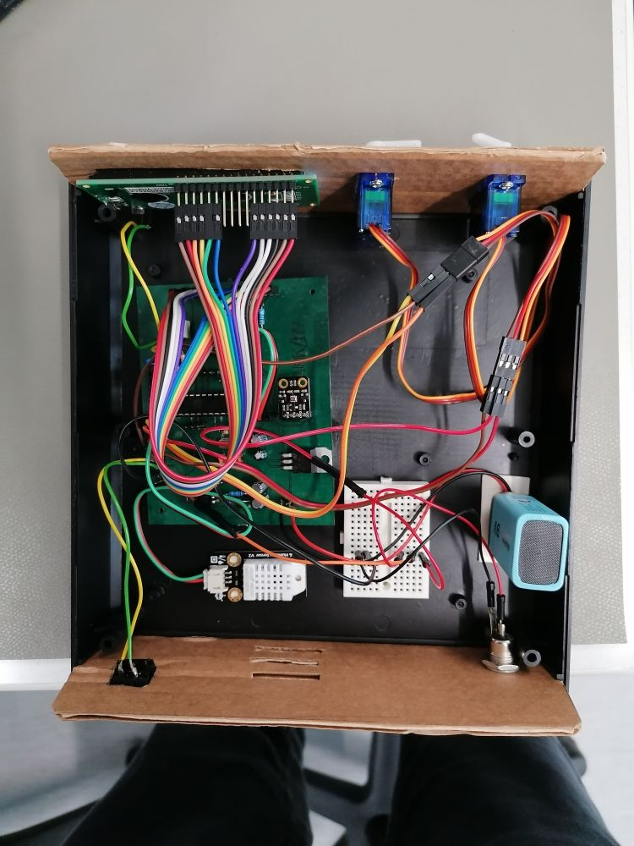
Final device
The Final device ended up bit messy due to the servos needing external power.
Over all the project was a success, as we got all the planned features to work.

